Slide 1
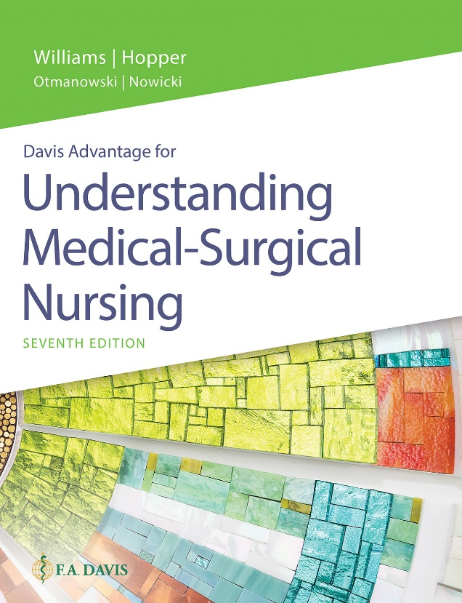
Book cover for Understanding Medical-Surgical Nursing, Seventh Edition.
Chapter 29
Respiratory System Function, Data Collection, and Therapeutic Measures

Slide 2
Learning Outcomes
Describe the normal structures and functions of the respiratory system.
Identify how aging affects the respiratory system.
List data to collect when caring for a patient with a respiratory disorder.
Recognize expected findings when inspecting, palpating, percussing, and auscultating the chest.

Slide 3
Learning Outcomes (continued)
Identify common diagnostic tests performed to diagnose disorders of the respiratory system.
Assist in planning nursing care for patients undergoing each of the diagnostic tests.
Discuss therapeutic measures used to help patients with respiratory disorders.

Slide 4
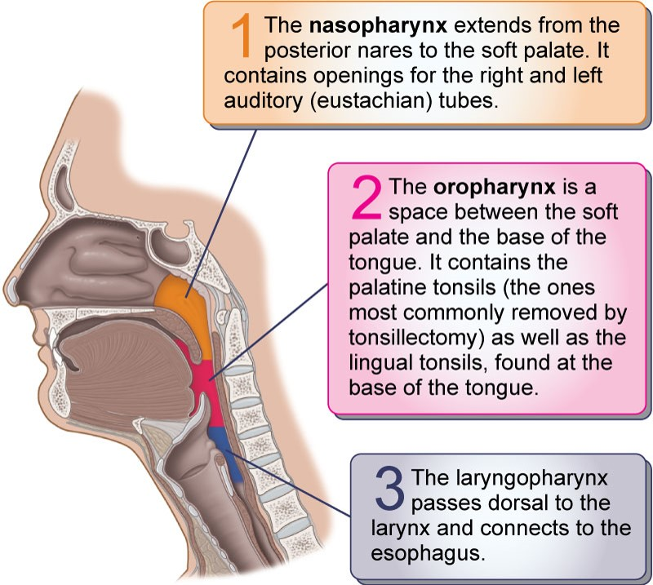
Review of Anatomy and Physiology

Slide 5
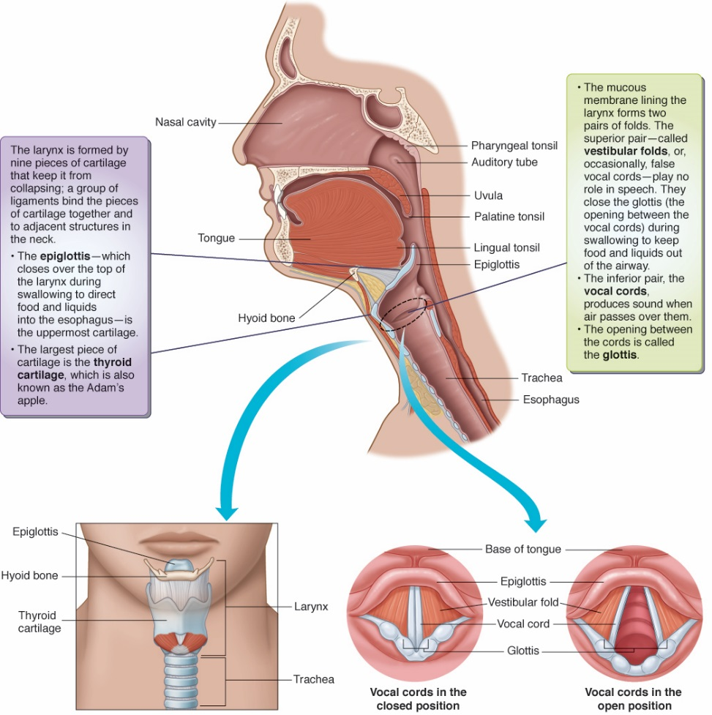
Review of Anatomy and Physiology (continued_1)

Slide 6
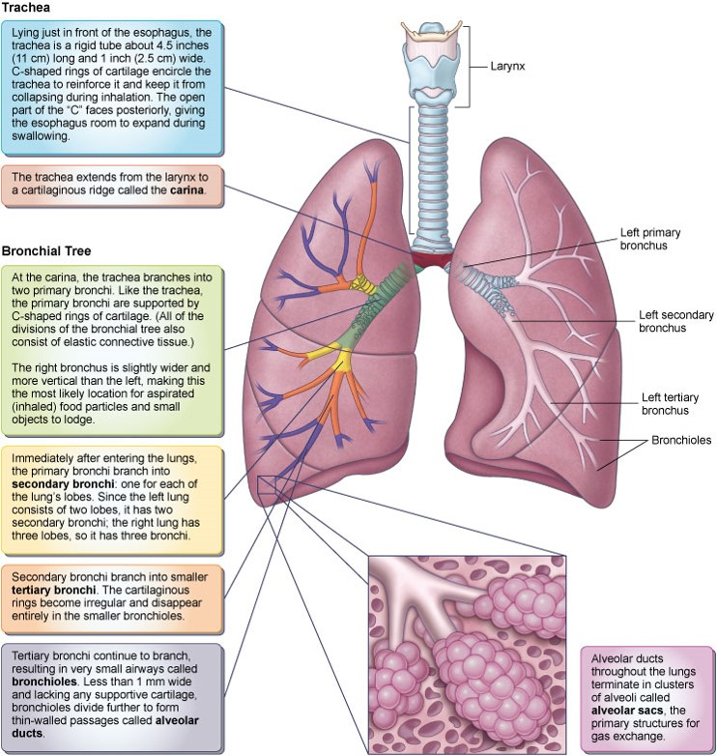
Review of Anatomy and Physiology (continued_2)

Slide 7
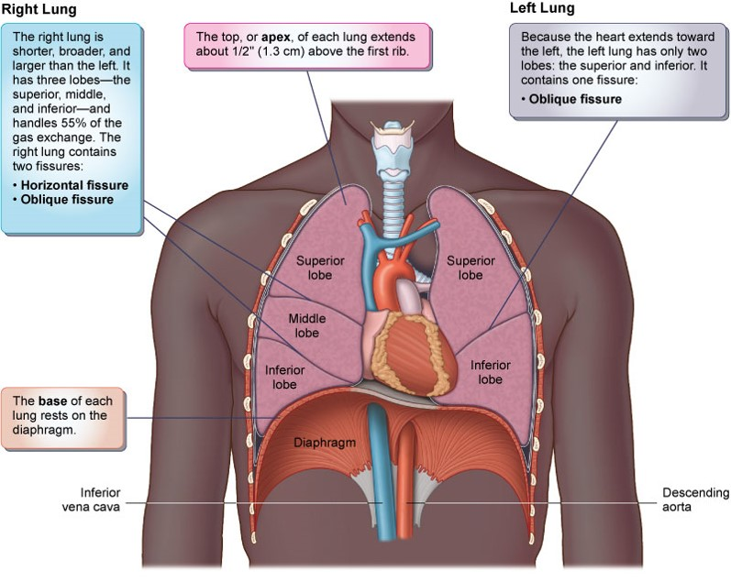
Review of Anatomy and Physiology (continued_3)

Slide 8
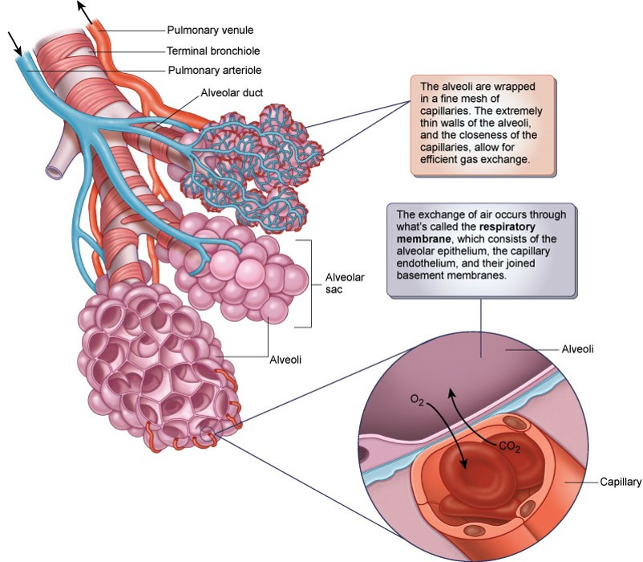
Review of Anatomy and Physiology (continued_4)

Slide 9
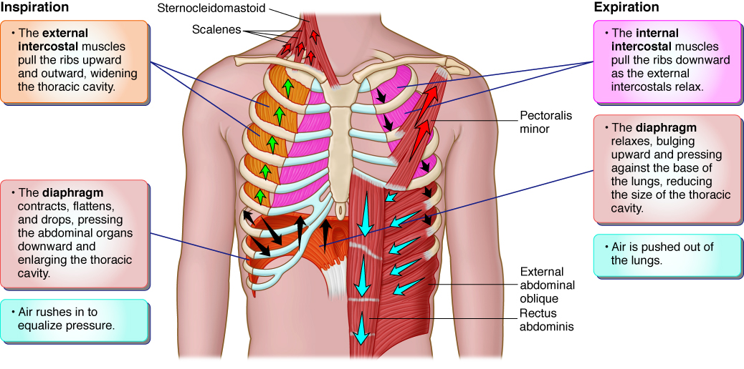
Review of Anatomy and Physiology (continued_5)

Slide 10
Acid–Base Balance
Respiratory acidosis
Hypoventilation
Respiratory alkalosis
Hyperventilation

Slide 11
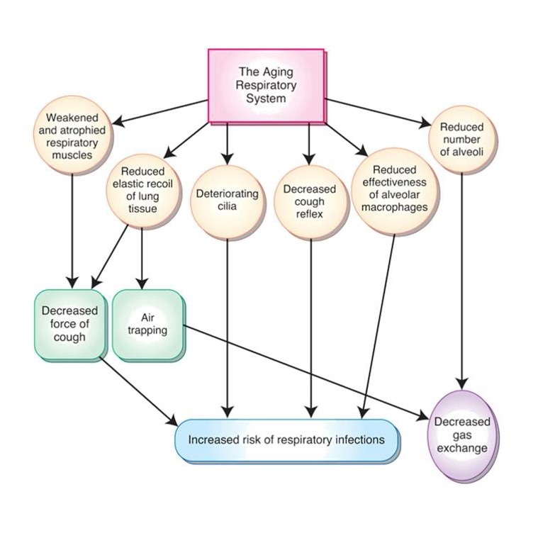
Effects of Aging

Slide 12
Health History
Upper respiratory symptoms
Lower respiratory symptoms
Exposures/smoking
Current treatments
Family history

Slide 13
WHAT’S UP?
Where is it?
How does it feel?
Aggravating and alleviating factors
Timing
Severity
Useful other data
Patient’s perception

Slide 14
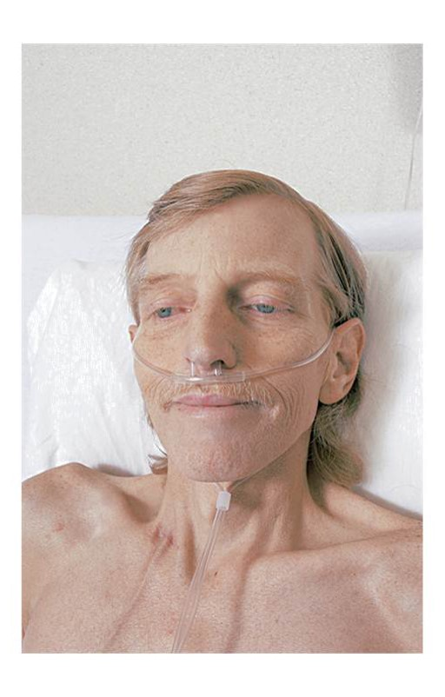
Inspection
Symmetry
Dyspnea
Use of accessory muscles
Color

Slide 15
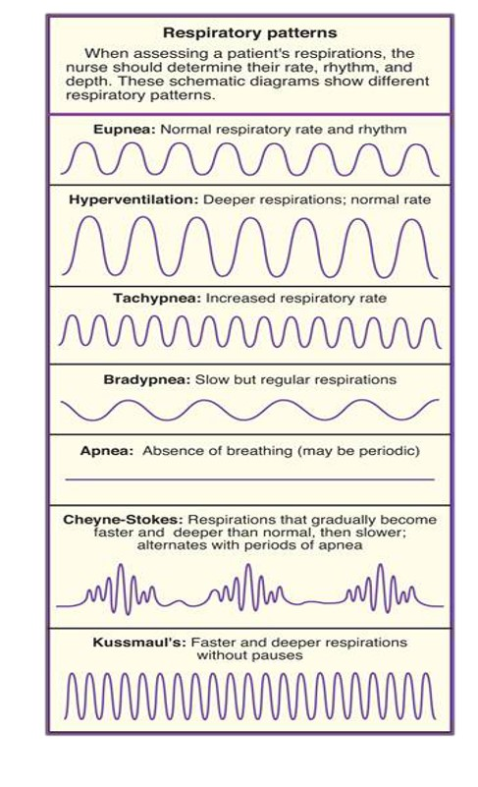
Inspection (continued)
Respiratory rate and rhythm
Chest shape

Slide 16
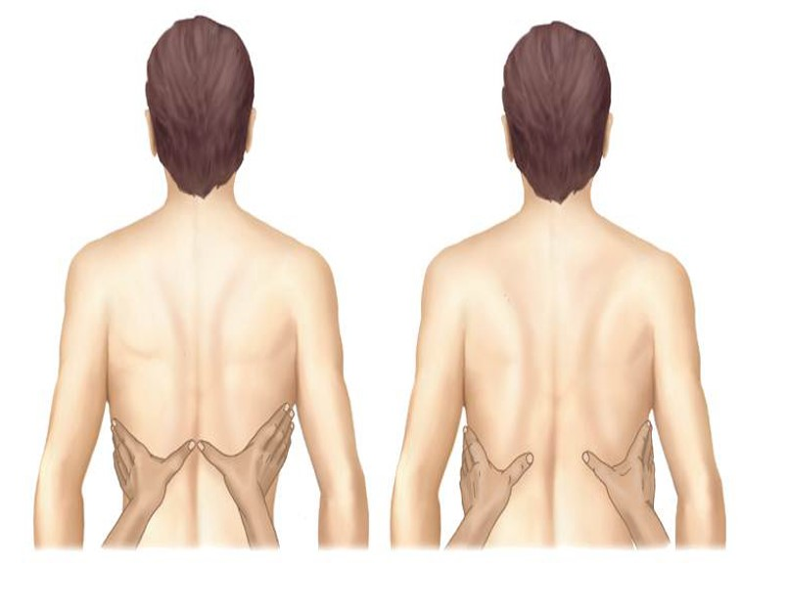
Palpation
Sinuses
Respiratory excursion
Crepitus

Slide 17
Percussion
Resonance
Hyper-resonance
Dull
Flat

Slide 18
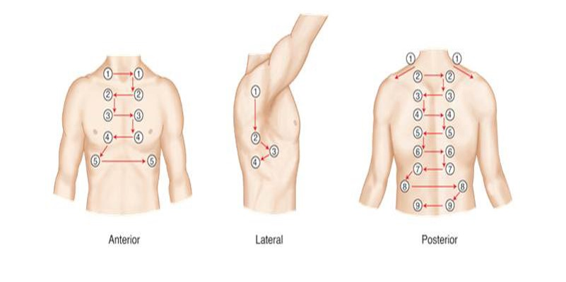
Auscultation
Normal breath sounds
Adventitious sounds
Compare bilaterally

Slide 19
Adventitious Breath Sounds
Crackles: Coarse or fine
Wheezes
Stridor
Friction rub
Diminished
Absent

Slide 20
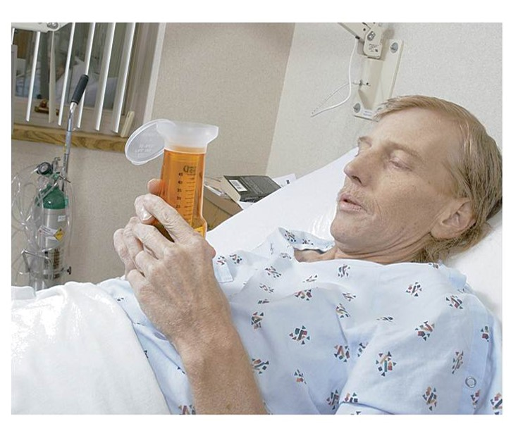
Laboratory Tests
Complete blood count
Arterial blood gases
D-dimer
Culture and sensitivity
Sputum, throat, nasal
Oxygen saturation
Capnography

Slide 21
Diagnostic Tests
Chest x-ray
Computed tomography (CT) scan
Ventilation-perfusion scan
Pulmonary function studies
Pulmonary angiography
Bronchoscopy

Slide 22
Smoking Cessation
Behavior modification
Counseling
Setting quit date
Nicotine replacement
Drug therapy
Hypnosis
Physical activity
E-cigarettes

Slide 23
Therapeutic Measures
Deep breathing and coughing
Huff coughing
Autogenic drainage
Breathing exercises
Diaphragmatic breathing
Pursed-lip breathing

Slide 24
Positioning
Fowler
Semi-Fowler
“Good lung down”

Slide 25
Oxygen Therapy
Nasal cannula
Oxygen masks
Transtracheal catheter

Slide 26
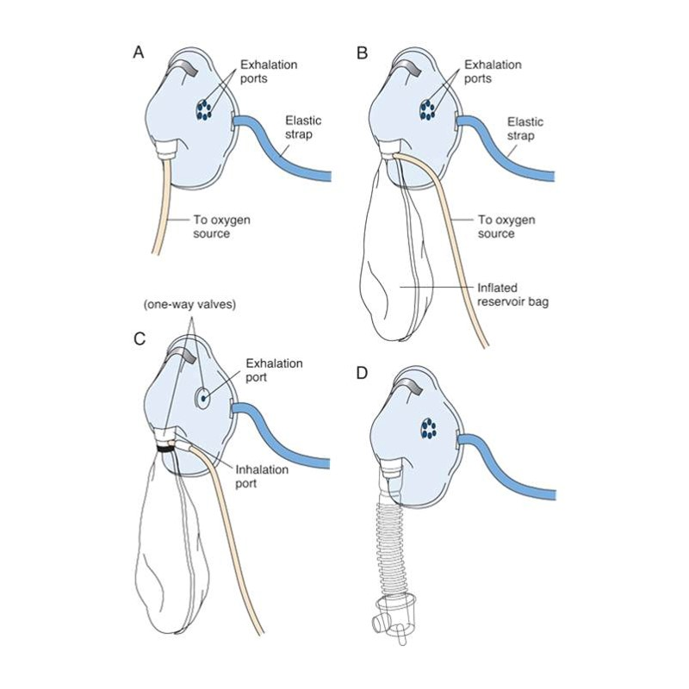
Oxygen Masks
Simple mask
Partial rebreather mask
Nonrebreather mask
Venturi mask

Slide 27
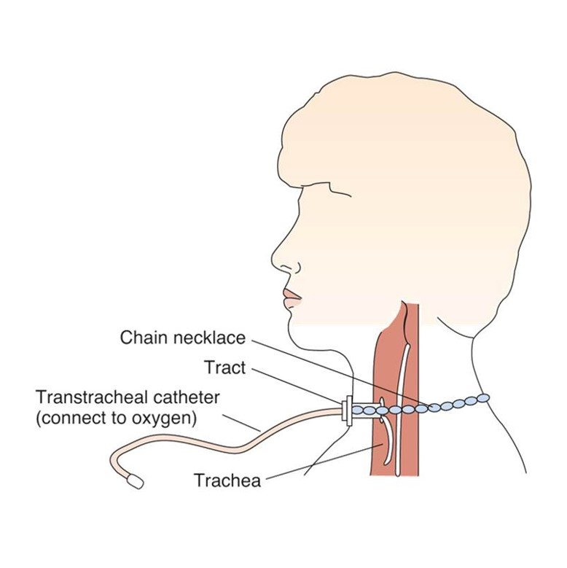
Transtracheal Oxygen

Slide 28
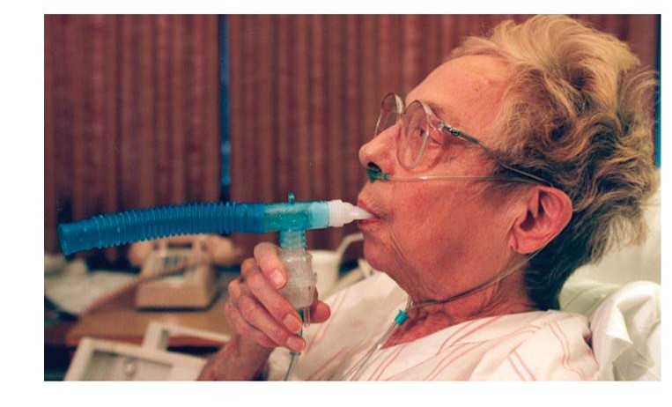
Nebulized Mist Treatment

Slide 29
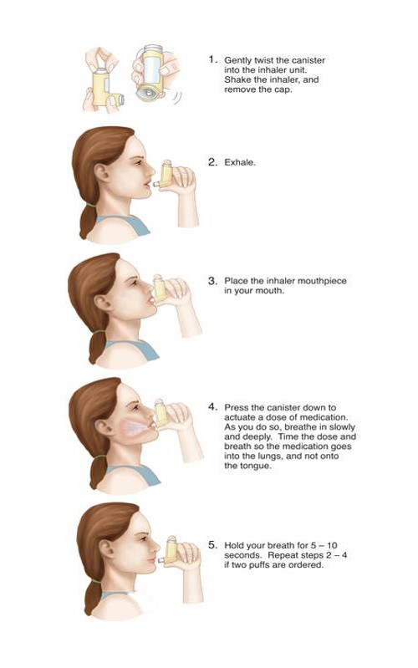
Metered-Dose Inhaler

Slide 30
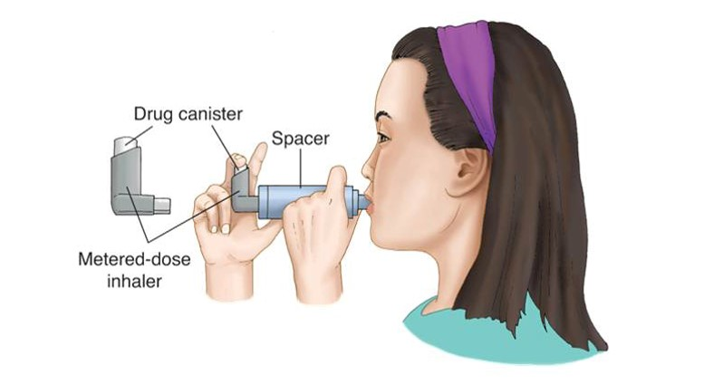
Spacer

Slide 31
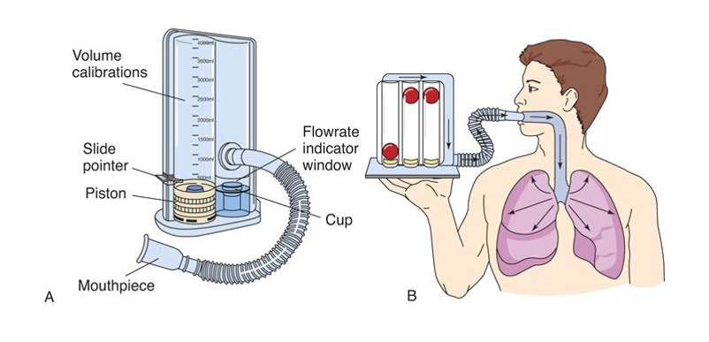
Incentive Spirometer

Slide 32
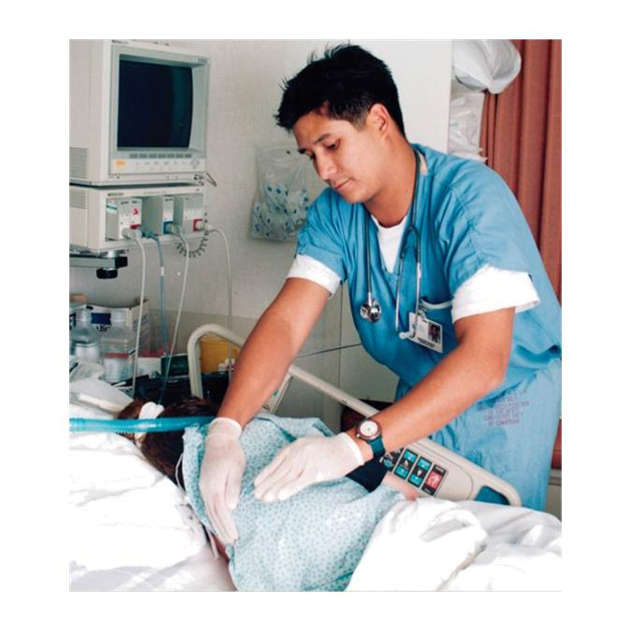
Chest Physiotherapy

Slide 33
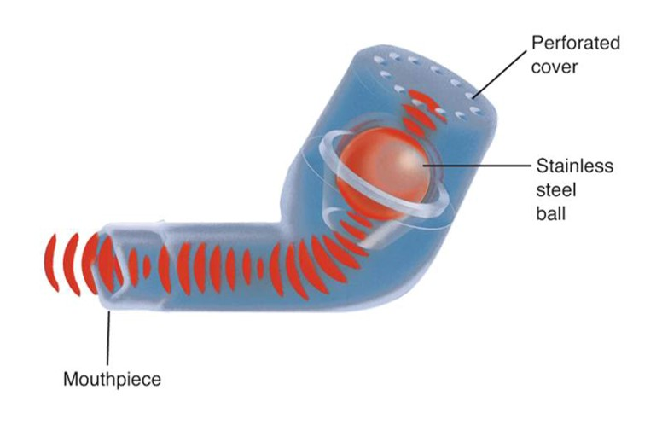
Vibratory Positive Expiratory Pressure (PEP) Device

Slide 34
Other Measures
High-frequency chest wall oscillation vest
Thoracentesis

Slide 35
Chest Drainage
Indications
Chest tube insertion
Drainage system
Nursing care

Slide 36
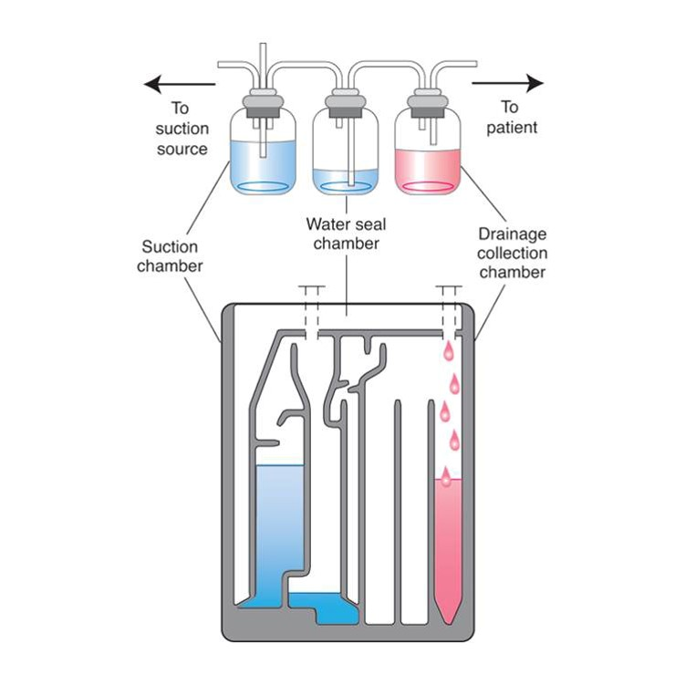
Chest Drainage System

Slide 37
Chest Drainage Data Collection
Patient
Tubing
Drainage system
Water seal chamber
Suction chamber
Drainage chamber

Slide 38
Tracheostomy
A tube inserted into the opening of the trachea to maintain patency indications
Nursing care
Suctioning
Cleaning
Communication
Teaching

Slide 39
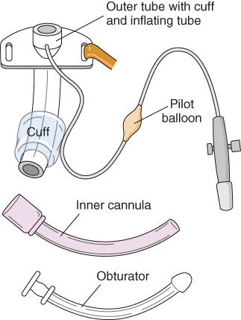
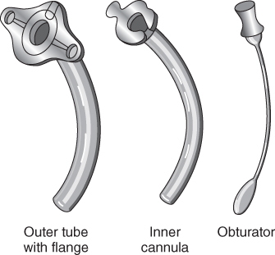
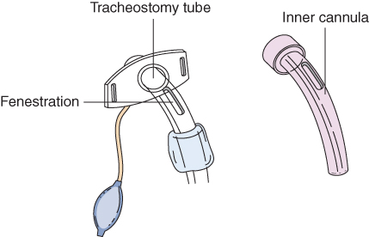
Tracheostomy (continued_1)
A. Metal tube B. Cuffed plastic tube C. Fenestrated tube

Slide 40
Tracheostomy (continued_2)
Nursing diagnoses
Ineffective Airway Clearance
Risk for Infection
Impaired Verbal Communication
Disturbed Body Image
Deficient Knowledge

Slide 41
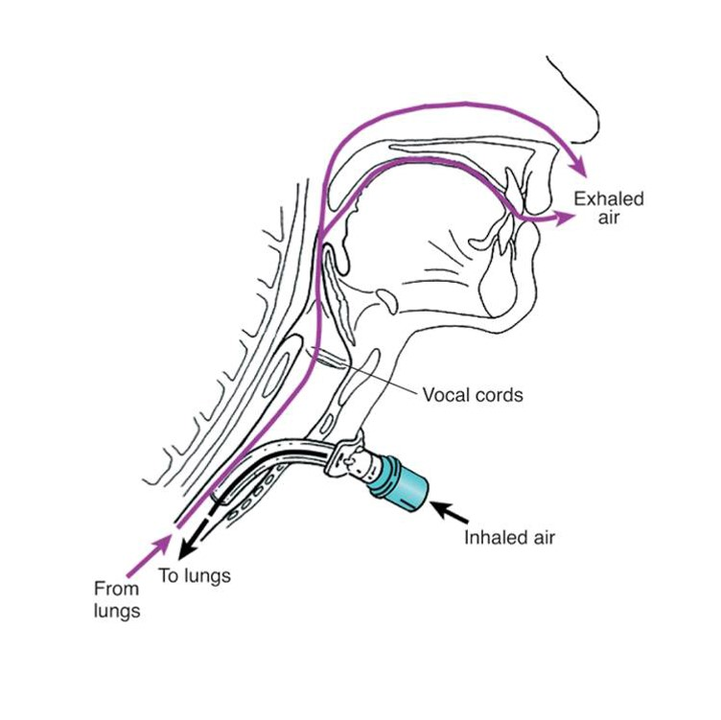
Passy Muir Speaking Valve

Slide 42
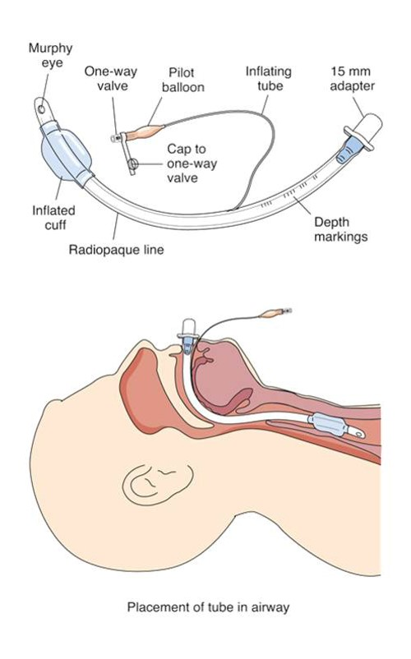
Intubation

Slide 43
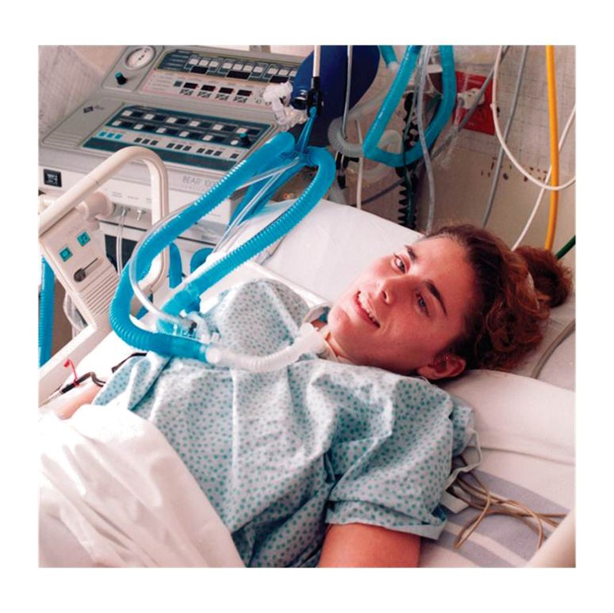
Mechanical Ventilation
Invasive
Indications
Troubleshooting alarms

Slide 44
Mechanical Ventilation (continued)
Nursing care
Check advance directives.
Use team approach.
Monitor patient.
Keep head of bed raised 30 to 45 degrees.
Provide oral care with chlorhexidine.
Suction as needed.
Assist with communication.

Slide 45
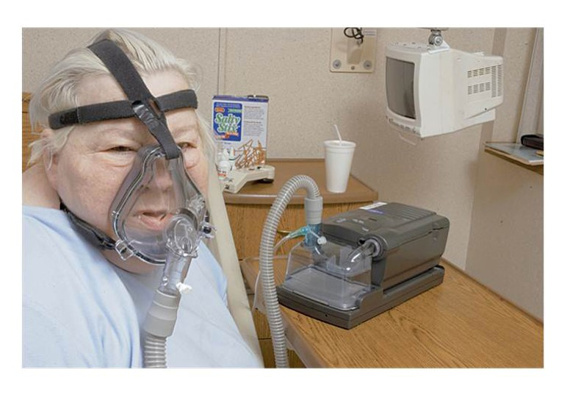
Noninvasive Positive-Pressure Ventilation (NIPPV)
Indications
Advantages
Nursing care

Slide 46
Review Question #1
What occurs in response to negative pressure in the thoracic cavity?
Pneumothorax
Dyspnea
Inhalation
Exhalation

Slide 47
Review Question #1 Answer
Correct Answer: 3

Slide 48
Review Question #2
Which acid–base imbalance results from impaired respiratory function?
Respiratory alkalosis
Respiratory acidosis
Metabolic alkalosis
Metabolic acidosis

Slide 49
Review Question #2 Answer
Correct Answer: 2

Slide 50
Review Question #3
Which adventitious breath sound is generated by narrowed inflamed airways?
Stridor
Friction rub
Crackles
Wheezes

Slide 51
Review Question #3 Answer
Correct Answer: 4

Slide 52
Review Question #4
What is the best method to recommend for smoking cessation? Select all that apply.
Nicotine replacement
Drug therapy
Behavior modification
Hypnosis
Setting a quit date

Slide 53
Review Question #4 Answer
Correct Answer: 1, 2, 3, 4, 5

Slide 54
Review Question #5
Which interventions can help patients expectorate sputum? Select all that apply.
Antihistamines
Vibratory positive expiratory pressure (PEP) device
Oxygen
Room humidifier
Huff coughing

Slide 55
Review Question #5 Answer
Correct Answer: 2, 4, 5

